Slide 1
Intro to Neuroimaging Analysis and BIDS
February 11, 2022
Matthew Defenderfer

Slide 2
What Is This Workshop For?
Organizing and processing MRI data is complicated.
Overall goal: set up a very basic workflow for downloading data, organizing it in a standardized structure, and performing basic preprocessing on T1w, T2w, and functional images
Tools:
XNAT
BIDS
fmriprep

Slide 3
What is BIDS
BIDS is the Brain Imaging Data Structure
BIDS is:
Organizing data in a folder
Naming files
Documenting metadata
Facilitating reuse by your future self and others
BIDS is not:
A file format
A data sharing platform

Slide 4
BIDS Benefits
Data reusability
Trying to figure out another person’s organization scheme is time-consuming and can frequently be frustrating
Data sharing
Standardization with documentation so other researchers will understand the data organization and more easily use the data
Study reproducibility
Standard organization will streamline the process to replicate the results from studies and write analysis pipelines that can be used across different datasets

Slide 5
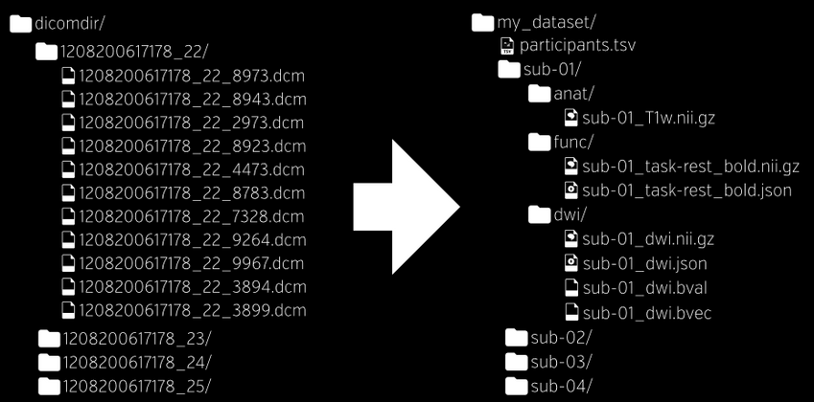

Slide 6
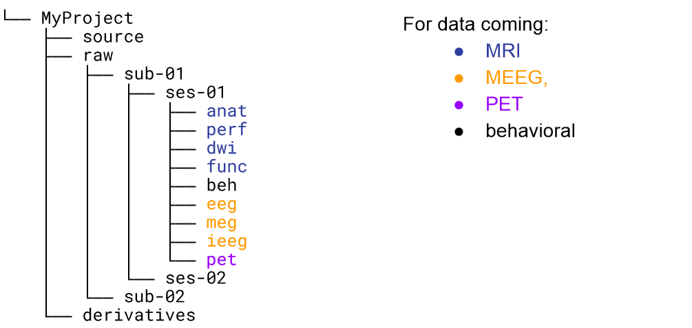
BIDS Folder Structure

Slide 7
BIDS Filenames
Filenames are built using a series of key-value pairs linked with – and _ and end with a suffix describing the scan type.
Examples:
T1w: sub-S01_ses-01_run-01_T1w.nii.gz
BOLD: sub-S01_ses-01_task-rest_dir-AP_run-01_bold.nii.gz
Diffusion: sub-S01_ses-01_dir-AP_run-01_dwi.nii.gz
Some keys are required for some scan types:
All scans require the sub key and a suffix
Functional scans require a task key and name
Spin Echo Fieldmaps require the dir key.

Slide 8
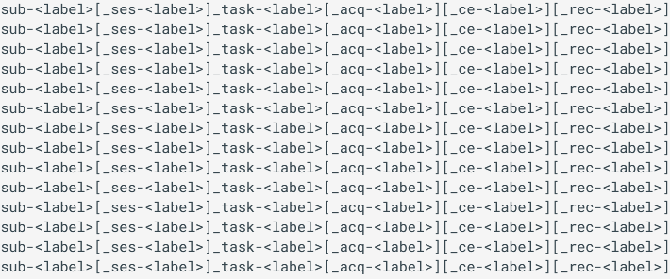
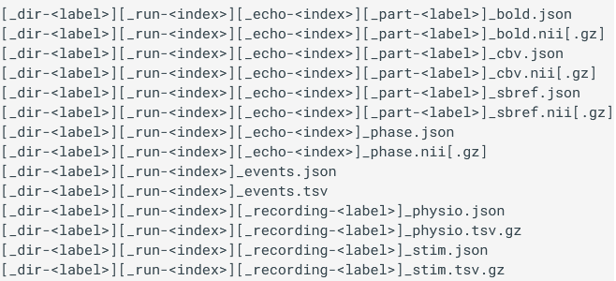
Many keys can be used to describe any file
All keys and their possible values for supported scan types can be seen at https://bids-specification.readthedocs.io/en/stable/04-modality-specific-files/01-magnetic-resonance-imaging-data.html

Slide 9
JSON Sidecars
Conversion from DICOM to nifti causes a net loss of information from the DICOM headers that could be useful down the line
BIDS requires that every scan have a corresponding json file with relevant metadata about the scan.
There is a list of required metadata for manual conversion out there, but the programmatic conversion creates these sidecars automatically
Sidecars have the exact same name as the scan they are matched to but end in .json instead of .nii.gz

Slide 10
Modality Agnostic Files
Files that describe holistic features of the dataset stored at the top level of the dataset directory tree
dataset_description.json (see here for more details)
Name of the dataset
BIDS version
Authors, and much more
Participants file (both tsv and json format, see here for more details)
Describe features of the participants such as age, sex, and handedness. For multigroup studies, group designation is also useful.

Slide 11
HeuDiConv
A Python tool used to convert dicoms to BIDS-formatted niftis given a mapping heuristic
Autogenerates JSON sidecars with basically all available metadata
Also generates dataset_description and participants files
General call: heudiconv -s <subject> [-ss <session>]
-d <path_to_all_subject’s_dicoms> -o <dataset_path>/nifti -f <heuristic> -c <converter> [-b] --overwrite
Session information can be excluded if design only had a single scan session
Notes:
For those who have a heudiconv not found error, run: PATH=$PATH:~/.local/bin

Slide 12
Heuristic File
Mapping file that associates each scan with its correct scan type and generates the scan names based on user-chosen keys
Python script that is created during the setup for HeuDiConv
Most errors or incorrect naming schemes can be traced back to incorrect heuristic setups.
Default heuristic and relevant dicom metadata for matching are created using: heudiconv -s <subject> -d <path_to_all_subject’s_dicoms> -o <dataset_path>/nifti -f convertall -c none –overwrite
Move the heuristic.py and dicominfo.tsv files from the .heudiconv folder to the main directory

Slide 13
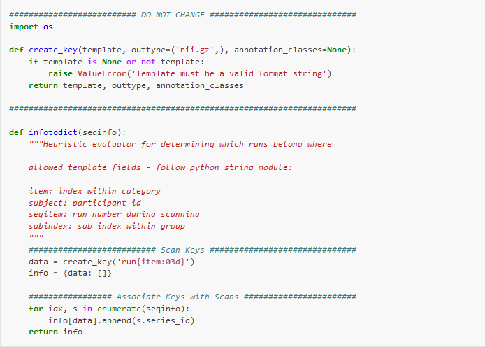
Default Heuristic
Only make changes for scan keys the for loop that sorts the scans

Slide 14
Scan keys
Template for the path and name of each scan type in the session. Uses the create_key function defined at the top of the heuristic
Values for the key-value pairs may change within scan type (ex. two functional scans, one with AP direction, and the other PA). These variable values should be inserted in {}.
Subject is also in {} because the heuristic will be used for all subjects in a dataset
Example anatomical:
t1w = create_key(‘sub-{subject}/anat/sub-{subject}_T1w’)
Example functional:
rest = create_key(‘sub-{subject}/func/sub-{subject}_task-{task}_dir-{dir}_run-{item:01d}_bold’)

Slide 15
Scan Keys
There should be a key for each type of scan in the session. This includes SBRef, fieldmaps, and other ancillary files.
Finally, each key should be added to the info dictionary statement after the last key is created but before the for loop starts. An example would look like:

Slide 16
Scan Sorting
The for loop sorts each scan to the correct key based on criteria given by the user.
This is also the point where variables such as direction and run number are specified
Criteria can include number of volumes, TR, TE, part of a scan name, etc.
As part of generating the generic heuristic, these scan matching parameters are also generated in the file dicominfo.tsv
Scans that are not associated with a key are not converted

Slide 17
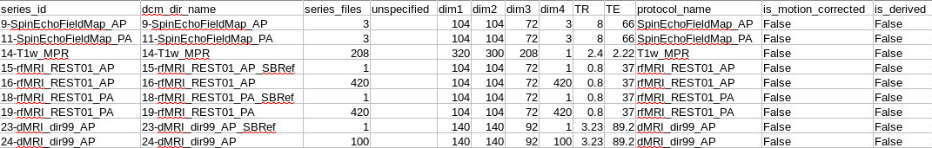
Dicom Info TSV

Slide 18
Example Sorting Commands
Sorting functional scans in our situation requires setting direction and run values
Example for the main BOLD scan:
Example for corresponding SBRef scan:
Every matching criteria assignment should assign values to the variable key-value pairs. For instance, for the rest key, the dir key-value pair is variable. The matching statement finds AP REST scans and assigns the dir key to be ‘AP’
The ‘item’ key seems to be always set to the series_id field

Slide 19
Sorting Can Exclude Unwanted Scans
Only scans who match the criteria to be assigned to keys will be converted to BIDS. Unmatched scans will have nothing done to them
The matching criteria can exclude scans such as localizers in this way, scans that may not serve a function in analysis or you want to exclude in favor of better scans such as intensity normalized vs non-normalized T1w and T2w images

Slide 20
Converting Scans
Once the heuristic is complete, scans can start to be converted
The function call is very similar to before with minor changes:
heudiconv -s <subject> -d <path_to_all_subject’s_dicoms> -o <dataset_path>/nifti -f <dataset_path>/heuristic.py -c dcm2niix -b --overwrite

Slide 21
BIDS Validator
Once the conversion is complete, we can validate the dataset using the online validator at http://bids-standard.github.io/bids-validator/
fmriprep also runs a BIDS validator at the start by default
The online tool does not read any actual data, only file names and folder structure, so PHI is not transferred at all.
Choose the nifti folder as that is the BIDS-sorted directory.
Warnings and errors will be displayed. Warnings do not necessarily need to be dealt with but will improve the quality of the dataset overall. Errors will need to be corrected immediately.
Once no errors appear, conversion to BIDS is complete!

Slide 22
Permissions Cleanup
Created files in the BIDS directory will be essentially locked as read-only by default.
fmriprep (and I assume other software) will need write permissions on the files in order to run correctly. To change the permissions, use the following command:
find <path/to/BIDS/subject> -type f -exec chmod ug+w {} \;

Slide 23
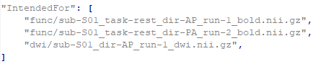
Associating Fieldmaps with Scans
For fmriprep to apply distortion correction to functional and diffusion scans, the scans must be associated with the fieldmaps.
To associate fieldmaps and scans, open the json sidecars for the fieldmaps and add the following field:
Replace the paths with relative paths to and names of the files to associate the fieldmaps with. If a session directory is included in your BIDS dataset, include it at the beginning of the path as well

Slide 24
fmriprep
fmriprep is a suite of tools for minimal preprocessing of anatomical (T1w and T2w) and functional data.
fmriprep expects and only works with data in BIDS format. Because of this, it’s fairly easy to set up
More information about fmriprep can be found at https://fmriprep.org/en/stable/

Slide 25
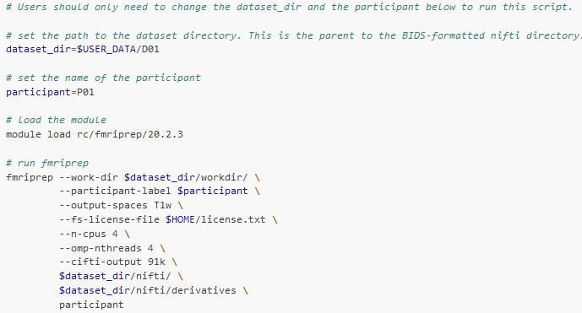
Example fmriprep script

Slide 26
Notes about the fmriprep call
When specifying the number of CPUs and threads, make sure you requested the correct number of resources for the job
You will need to copy the freesurfer license file from the module to your home directory to run fmriprep. This can be done with the following command:
cp /share/apps/rc/software/FreeSurfer/7.1.1-centos7_x86_64/license.txt $HOME
Other options exist to use in the function call. Look through the main documentation to find what all you need for your dataset.

Slide 27
Fmriprep Outputs
Will output preprocessed structural and functional images in the user-specified space.
Functional images will be distortion corrected and registered to the anatomical
Various template spaces are available to choose from in TemplateFlow
CIFTI outputs for 32k grayordinate space are possible (called 91k in fmriprep parlance)
Figures for visual analysis of preprocessing are also output

Slide 28
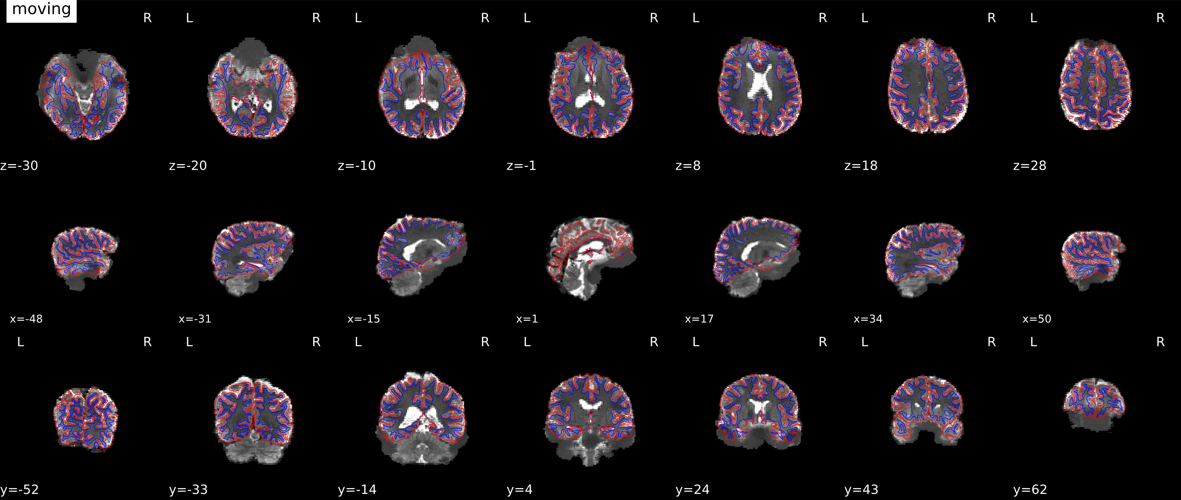
bbregister Overlay

Slide 29
Documentation
Basic documentation on using XNAT, BIDS, and fmriprep with example scripts can be found at https://cinl-docs.rtfd.io
More documentation will be added over time. Suggestions and requests on tutorials or documentation to add can be submitted to the discussions tab on the github page https://github.com/uabrc/CINL-Docs

Slide 30
Contact
Research Computing office hours
Mondays and Thursdays from 10-12 on Zoom
Links can be found at the top of the rc.uab.edu page.
Email: mdefende@uab.edu
Intro to R Workshop: Research Computing Day on March 2

